Slide 1

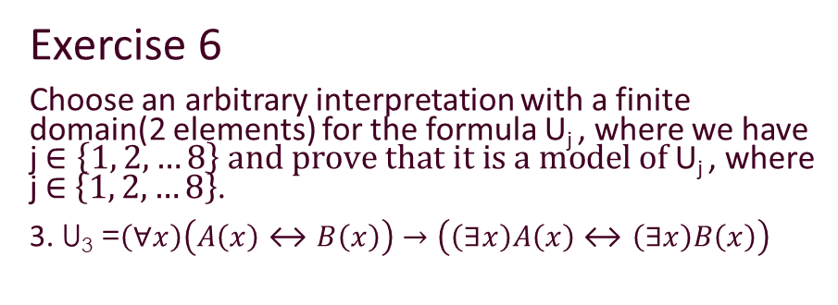
Problem statement
Exercise 6
Choose an arbitrary interpretation with a finite domain(2 elements) for the formula U_{j} , where we have j $∈\left\{1, 2, …8\right\} and prove that it is a model of$U_{j} , where j $∈$ $\left\{1, 2, …8\right\}$.
3. U₃ =$\left(∀x\right)\left(A\left(x\right)↔B\left(x\right)\right)→\left(\left(∃x\right)A\left(x\right)↔\left(∃x\right)B\left(x\right)\right)$

Slide 2
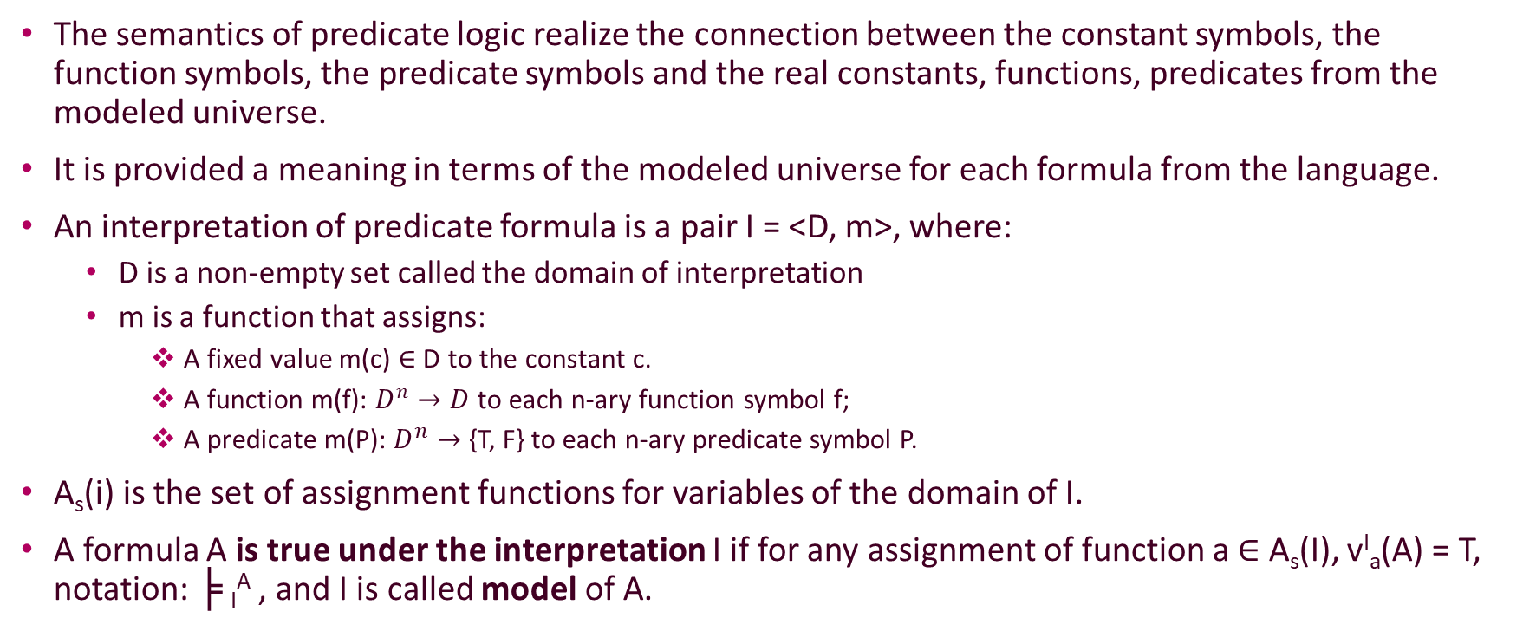
Theoretical results
The semantics of predicate logic realize the connection between the constant symbols, the function symbols, the predicate symbols and the real constants, functions, predicates from the modeled universe.
It is provided a meaning in terms of the modeled universe for each formula from the language.
An interpretation of predicate formula is a pair I = <D, m>, where:
D is a non-empty set called the domain of interpretation
m is a function that assigns:
A fixed value m(c) $∈$ D to the constant c.
A function m(f): $D^{n}→D$to each n-ary function symbol f;
A predicate m(P): $D^{n}→$ {T, F} to each n-ary predicate symbol P.
A_{s}(i) is the set of assignment functions for variables of the domain of I.
A formula A is true under the interpretation I if for any assignment of function a $∈$ A_{s}(I), v^{I}_{a}(A) = T, notation: ╞ _{I}^{A} , and I is called model of A.

Slide 3
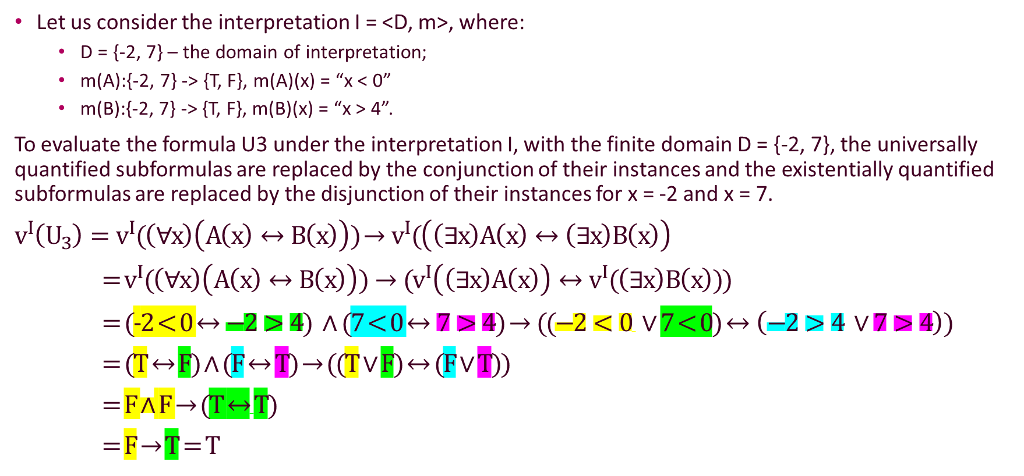
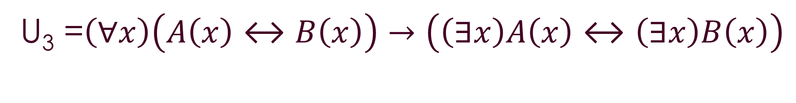
U₃ =$\left(∀x\right)\left(A\left(x\right)↔B\left(x\right)\right)→\left(\left(∃x\right)A\left(x\right)↔\left(∃x\right)B\left(x\right)\right)$
Let us consider the interpretation I = <D, m>, where:
D = {-2, 7} – the domain of interpretation;
m(A):{-2, 7} -> {T, F}, m(A)(x) = “x < 0”
m(B):{-2, 7} -> {T, F}, m(B)(x) = “x > 4”.
To evaluate the formula U3 under the interpretation I, with the finite domain D = {-2, 7}, the universally quantified subformulas are replaced by the conjunction of their instances and the existentially quantified subformulas are replaced by the disjunction of their instances for x = -2 and x = 7.
$v^{I}\left(U_{3}\right)=v^{I}(\left(∀x\right)\left(A\left(x\right)↔B\left(x\right)\right))$ $→v^{I}(\left(\left(∃x\right)A\left(x\right)↔\left(∃x\right)B\left(x\right)\right)$
= $v^{I}(\left(∀x\right)\left(A\left(x\right)↔B\left(x\right)\right))→{(v}^{I}\left(\left(∃x\right)A\left(x\right)\right)↔v^{I}(\left(∃x\right)B\left(x\right)))$
= (-2 < 0 $↔−2>4) ∧$ (7 < 0 $↔7>4$) $→((−2<0 ∨$ 7 < 0) $↔\left(−2>4 ∨7>4\right))$
= (T $↔$ F) $∧$ (F $↔$ T) $→$ ((T $∨$ F) $↔$ (F $∨$ T))
= F $∧$ F $→$(T $↔$T)
= F $→$ T = T

Slide 4

CONCLUSION
I evaluates the formula $U_{3}$ as true so I is a model of $U_{3}$.

